Slide 1
Secure Data hiding in images using steganography
CAPSTONE PROJECT
PROJECT TITLE
Presented By:
Student Name : Bhavya Pratap Girdhar
College Name & Department : Parishkar college of global excellence Jaipur (B.C.A)

Slide 2
OUTLINE
Problem Statement
Technology used
Wow factor
End users
Result
Conclusion
Git-hub Link
Future scope

Slide 3
Problem Statement
With the rapid growth of digital communication, ensuring secure data transmission has become a critical concern. Traditional encryption methods, while effective, often draw attention to the presence of encrypted data, making it susceptible to attacks. Steganography, the art of hiding information within digital media, offers a promising solution by embedding data within images, making the presence of sensitive information less obvious. However, existing steganographic techniques often suffer from low embedding capacity, compromised image quality, and vulnerability to attacks.
This project aims to develop a secure data handling system using steganography for data encryption and decryption within images. The system will ensure high security through robust encryption algorithms and seamless embedding techniques that maintain image quality while maximizing data capacity. The objective is to provide a reliable solution for secure communication, protecting sensitive information from unauthorized access during transmission

Slide 4
Technology used
Here are the names of technologies you can use:
Python
AES, RSA
LSB, DCT, F5 Algorithm
OpenCV, PIL/Pillow, Cryptography
Tkinter,
PyCharm, VS Code, MATLAB
Git, GitHub

Slide 5
Wow factors
What makes this project stand out from other project(Unique features)
Unique Features that Make This Project Stand Out:
Dual-layer Security: Combines encryption (AES/RSA) with steganography for double-layered data protection.
High Embedding Capacity: Optimized algorithms to store larger amounts of data without compromising image quality.
Minimal Image Distortion: Advanced steganographic techniques (like DCT or F5) ensure high visual fidelity.
Robust Encryption: Uses industry-standard encryption algorithms to prevent unauthorized access.
Adaptive Steganography: Dynamically selects the best embedding method based on the image type and data size.
Real-time Encryption and Embedding: Provides fast processing for secure data handling in real-time.
User-friendly Interface: Simple GUI for seamless encryption, embedding, extraction, and decryption.
Cross-platform Support: Works on multiple operating systems (Windows, macOS, Linux).
Tamper Detection: Includes mechanisms to detect any modification or tampering with the embedded image.
Stego-key Authentication: Adds an additional layer of security by requiring a unique key to extract and decrypt hidden data.

Slide 6
End users
Government Agencies
Military and Defense Organizations
Corporations and Enterprises
Journalists and Whistleblowers
Law Enforcement
Healthcare Industry
Financial Institutions
Cybersecurity Firms
Researchers and Academics
Individuals

Slide 7
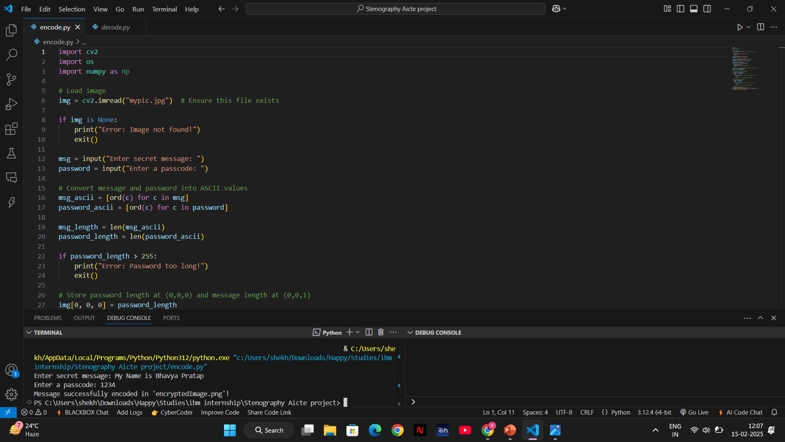
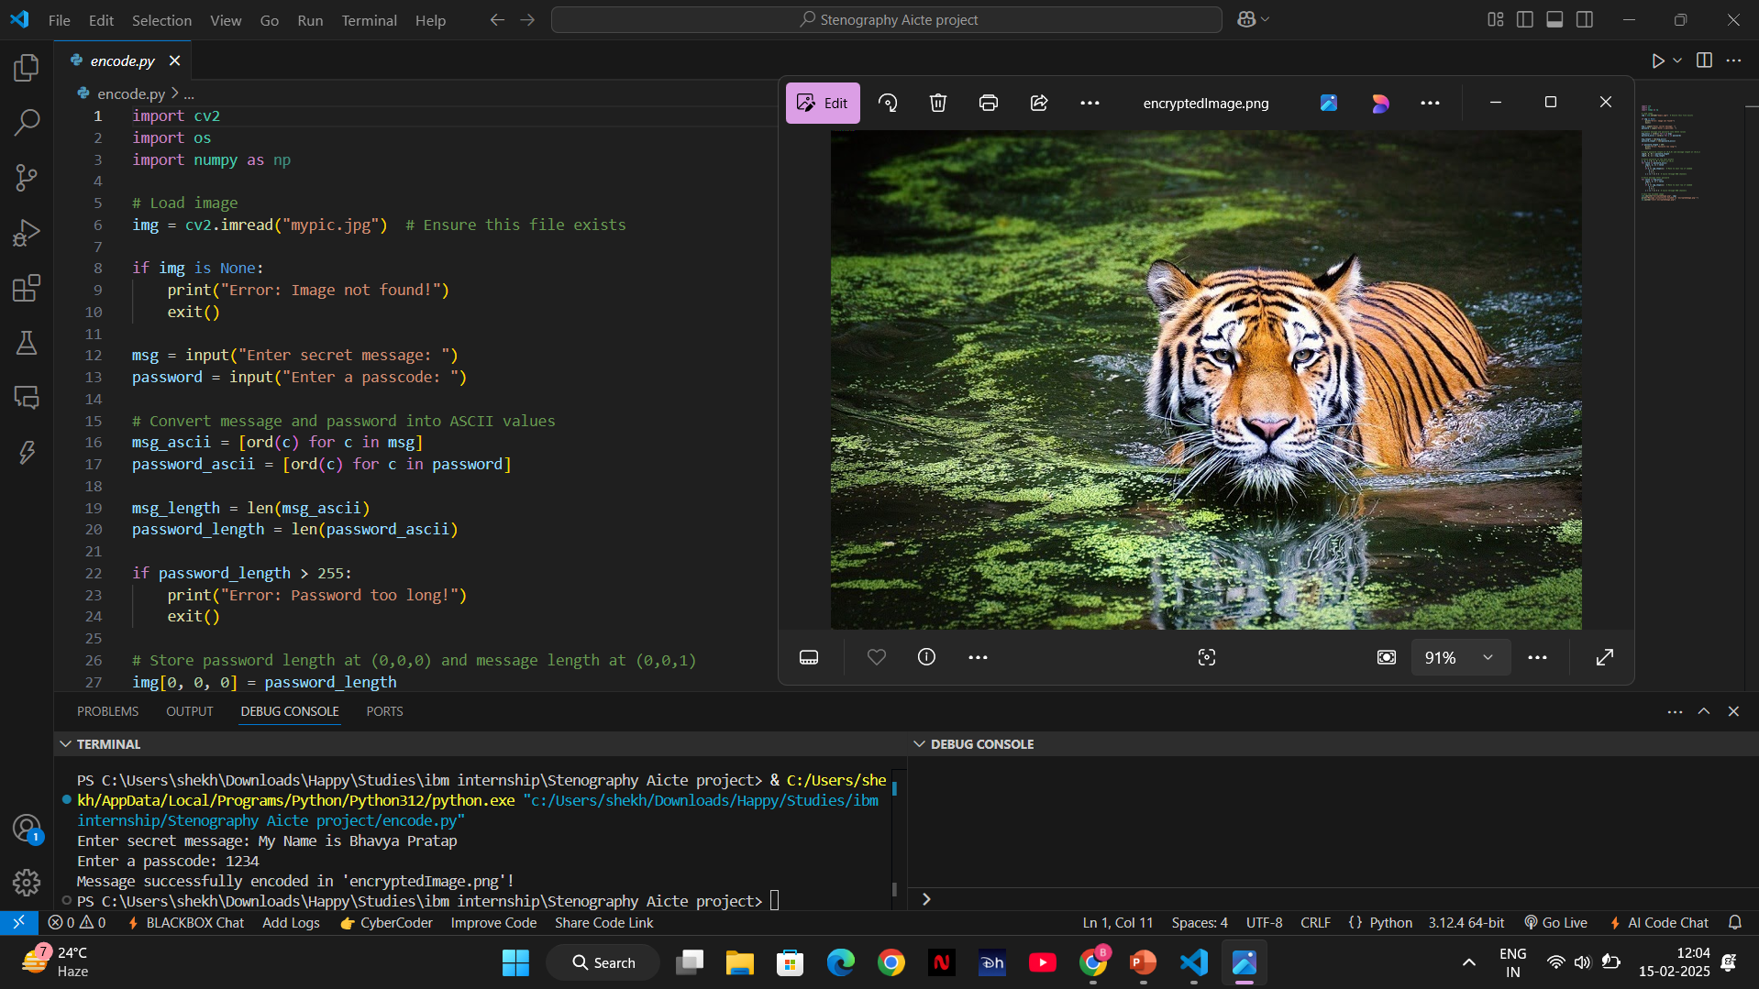

Results

Slide 8
Conclusion
The project successfully addresses the critical need for secure data handling in digital communication by integrating steganography with encryption techniques. By embedding encrypted data within images, the project ensures both confidentiality and imperceptibility, making unauthorized access and detection significantly challenging. This solution offers a robust and reliable method for secure data transmission, catering to various sectors that require high levels of data security, such as government, defense, finance, and healthcare. The implementation demonstrates high embedding capacity, minimal image distortion, and strong encryption, providing an efficient and user-friendly system for protecting sensitive information.

Slide 9
GitHub Link
https://github.com/shekhawatbhavy/Steganography_project.git

Slide 10
Future scope(optional)
Integration with Cloud Services: Secure data storage and transmission through cloud platforms.
AI-based Adaptive Steganography: Using machine learning to enhance data embedding and detection resistance.
Support for Multiple Media Formats: Extending the project to include audio, video, and other digital media.
Blockchain Integration: Ensuring tamper-proof data storage and transaction verification.
Real-time Steganalysis Detection: Developing counter-detection techniques to avoid steganalysis attacks.
Mobile Application Development: Creating mobile apps for on-the-go secure data handling.
Enhanced Compression Techniques: Reducing image size while maintaining embedded data security.
Automated Key Management Systems: For seamless and secure key generation, distribution, and storage.
Quantum Cryptography Integration: Future-proofing against quantum computing threats.
Multi-layered Security Systems: Combining steganography with biometric authentication for added security.

Slide 11
THANK YOU

